Slide 1
Hydrologic Modeling in SRH and SMS
August 29, 2024
2024 National Hydraulic Engineering Conference
Notes:
This presentation will highlight new functionality that is currently being tested in the SRH / SMS platform for hydrologic simulation.

Slide 2
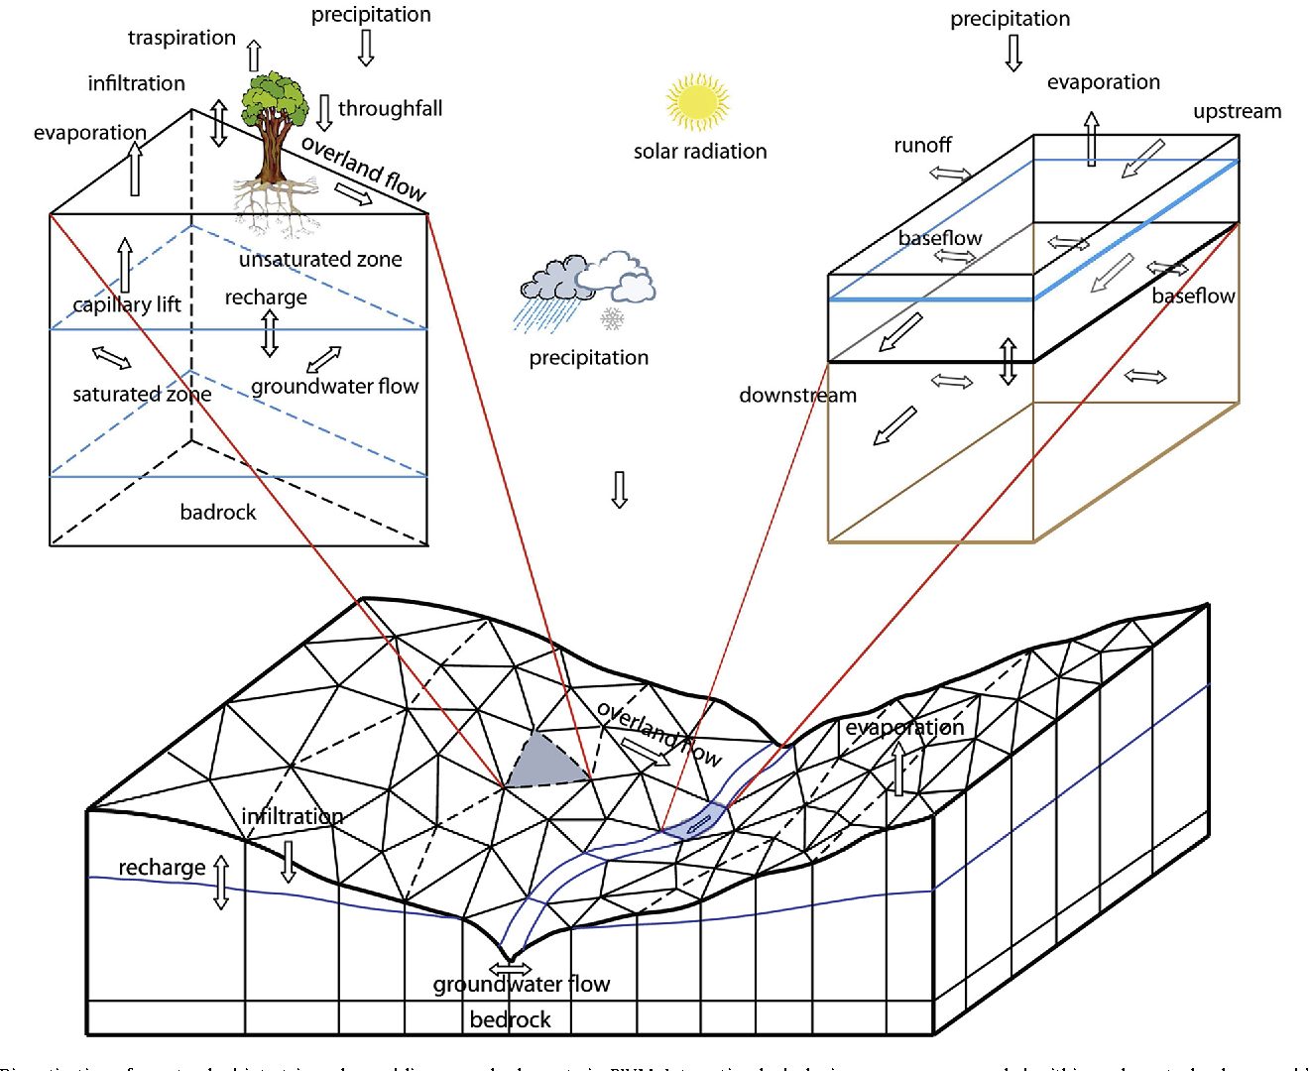
Outline
Hydrologic Modeling
General
In SRH
SRH-W, SRH-ONE, SRH-2D ?
Unstructured
In SMS
Data Services
Mesh Generation
Dataset Creation
Model Interface
Example Workflow

Slide 3
Hydrologic Modeling
Basin Scale – Watershed
“Inflows” from rain, snow melt, groundwater
Generally, much larger scale than hydraulics
Transient (Varying time scale)
Event based
Long-term
Many parameters
Meteorology (rain, wind, solar, …)
Geology (soil, stratigraphy, water table, …)
Land use (vegetation, permeability, …)
Many uncertainties (+/- 30% ???)
Notes:
Notes:
Generally, much larger scale
Usually means lower resolution or very expensive computation
Transient – event based or long term
Event based requires extensive “initial” or “antecedent” conditions
Parameters…

Slide 4
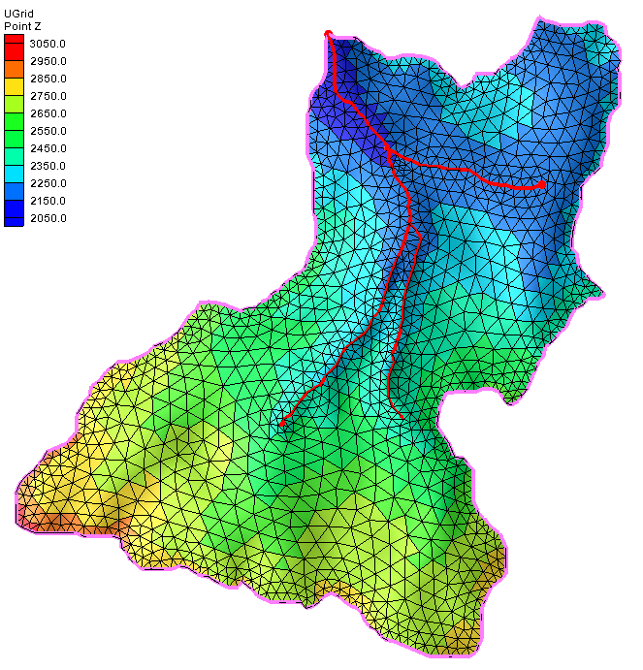
Hydrology in SRH
SRH-2D History
Flexible – use UGrid
Unstructured grid
Cells should follow streams
Cell based datasets
Bedrock elevation
Sat/Unsat thicknesses
Temperature
Rainfall
Gage based
Notes:
Like SRH-2D hydraulics, the hydrology is not on a regular grid.
Recommendation is to us an SMS UGrid
Cell based datasets
Most datasets in SMS / SRH-2D have historically been point based
SRH-2D computes values at the cells but they have been interpolated to the nodes for intuitive visualization
SRH-2D has used a cell-based approach for
Material type
Ceiling elevation
For hydrology in SRH, additional cell-based datasets are used.
Working model for internal projects.
Release to public anticipated.

Slide 5
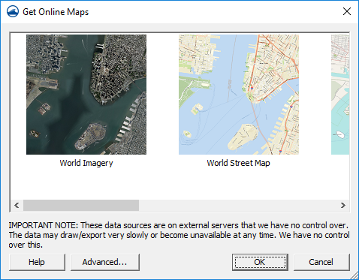
Hydrology Tools New in SMS
Data Acquisition
Mesh vs UGrid
Datasets
Conformity
Generation
Unstructured feature based
Toolbox
Python based tools (individual functionality)
Watershed Delineation – (Watershed from Raster)
Stream networks to channels – (Polygons from Arcs)
UGrid generation – (UGrid from Coverage)
Notes:
Specific tool name included in parenthesis

Slide 6
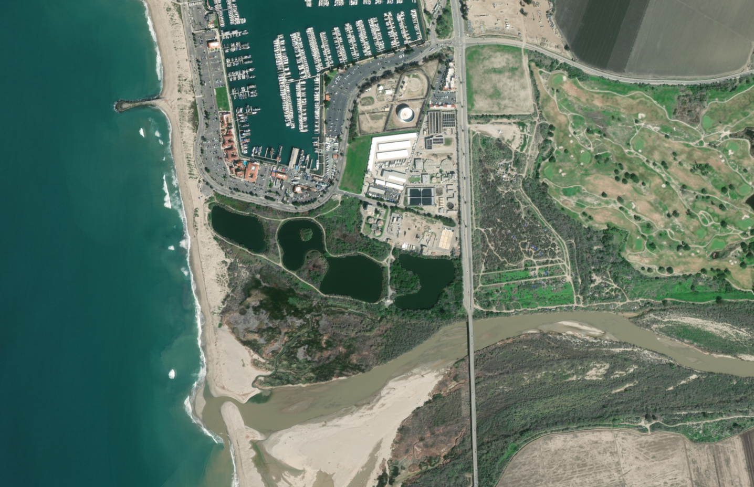
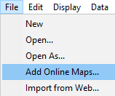
Download from Web / Online Data Links
Download – Retrieve data for specified region and load into SMS
Online – Maintain link to web service and update with view
Notes:
SMS includes features to download data for a selected region from web service sources or link to web service (dynamic maps).
Two commands in the “File” menu
Tools connected to the “Import from Web” macro (screen bounds or drag a box) and “Add Online” macro
Support for a single tile service
Support for a few feature services
Support for multiple map (image) services
Seamless map sources that load images from the service using current screen area in the display projection.
Can be converted to a static image.

Slide 7
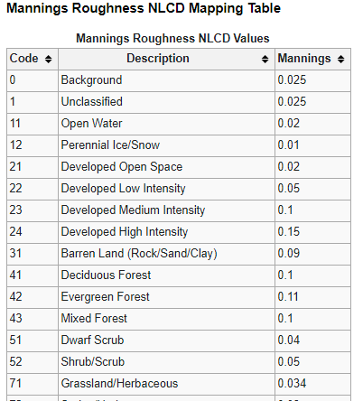
Available Data Sources
Terrain
USGS 3DEP Bare Earth DEM
Worldwide Elevation Data
Others (Open Topography, CUDEM, SRTM15+)
Land Use
NLCD 2011, 2006 (2021 now available)
C-CAP (CONUS and Hawaii)
Soil Type
Statsgo (state files)
Ssurgo (county files)
Global Land Cover
Harmonized World Soil Database v 1.2
Notes:
SMS includes specific connections to some web services
The interface allows user to configure connection to other services which follow protocols
Source Resolution Coverage
Terrain
USGS 3DEP Bare Earth DEM 1 m CONUS land
World Wide Elevation Data 3.7 m max world wide land
Open Topography pt data variable includes access to many other sources (SRTM15+, GEBCO,
CUDEM 3.4 m (1/9 arc second) partial
Land Cover
NLCD 30 m CONUS land
C-CAP 1-5 m CONUS and Hawaii
Soil type
Statago Vector polygons CONUS
Ssyrgi Vector polygons CONUS

Slide 8
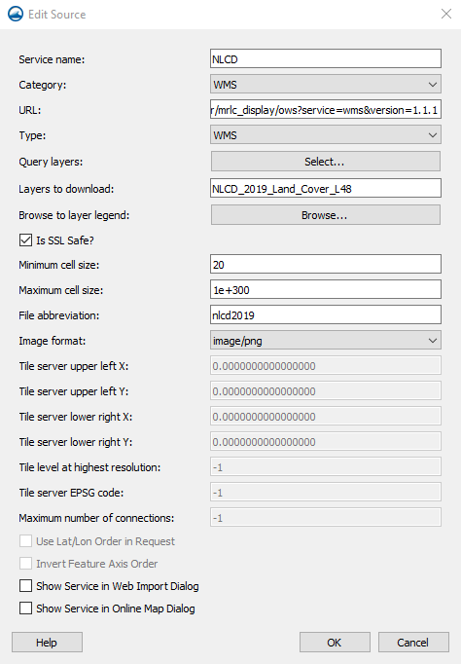
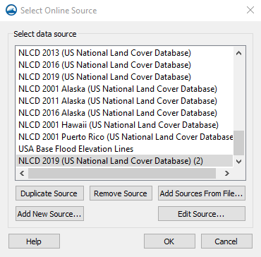
“Advanced…” Sources
User can associate additional web services with SMS
Duplicate and modify existing web service
Add link to new web service
Add services view csv file
Add to the “defaults” list
Notes:
Sources require:
Name – Usually user selected
Category (WMS, WFS, TMS) – Subtype required for WMS
URL
Layer (based on service). This can be queried in the dialog
Cell size limits
File abbreviation (for download)
Format
Can be flagged to appear on the main page as a “default” service in SMS

Slide 9
2D Mesh vs UGrid
Datasets
2D Mesh supports only “node” based
UGrid supports “node” and “cell” based
Conformity
2D Mesh supports triangles and quadrilaterals
UGrid supports all polygonal cells
Voronoi
Refinements (i.e. Quad tree)
Can be constrained to limit cell types in a specific grid
Notes:
Add pictures

Slide 10
2D Mesh or UGrid Generation – Best Practices
Minimize digitization and manual editing
Feature extraction
Streams
Ridges
Structures
Bridges
Culverts
Notes:
Do we want to keep this slide?

Slide 11
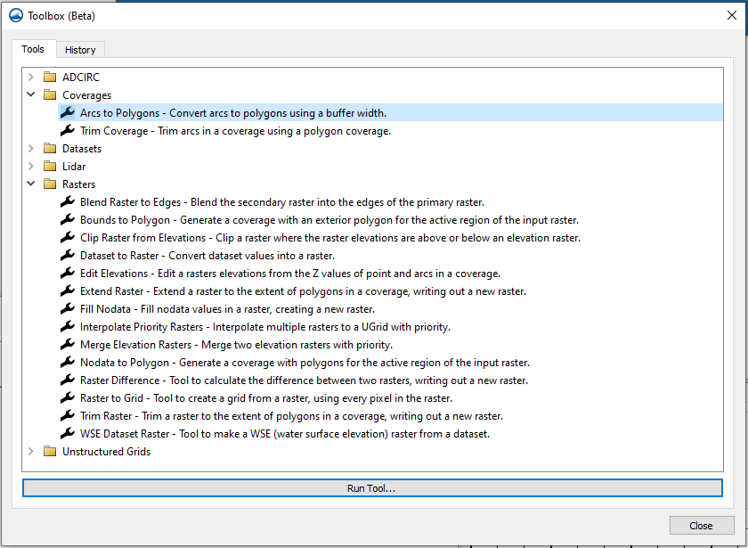
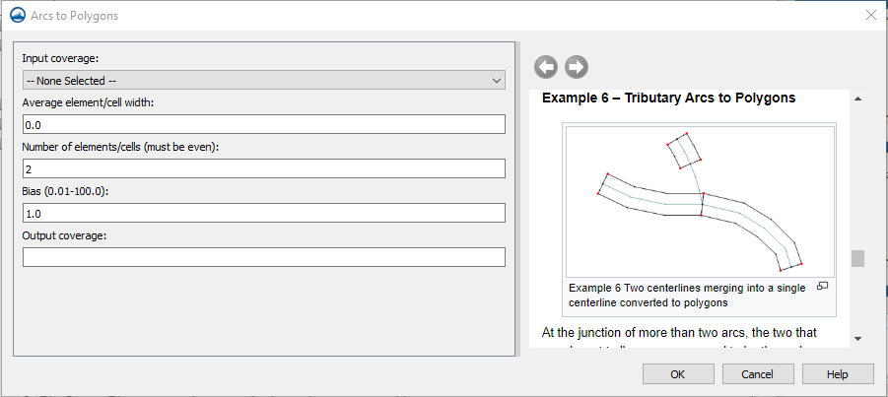
Toolbox
Python based tools
Each tool is a library
Standard layout
Includes help pane
History
Notes:
The development of SMS continues to evolve. Current methodology emphasizes compartmentalization of functionality in Python libraries. This is illustrated in a new “Toolbox” available in SMS 13.2.
Engine specific interface tools are also being added.
This presentation will highlight many of these tools. Rather than simply summarize the tools, they will be presented via a workflow to create unstructured meshes for SRH-2D simulations.
The toolbox is divided into groups (folders) and includes a history option. When each tool is launched an interface dialog appears with associated help/instructions. More complex tools may have custom interfaces.

Slide 12
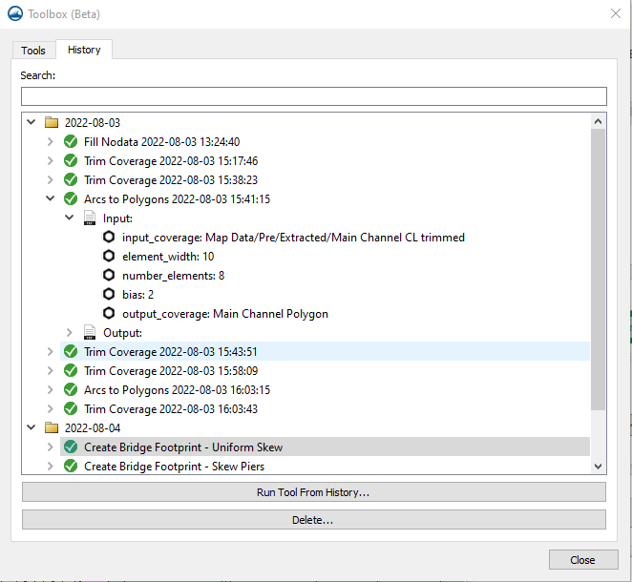
Toolbox History Function
Re-run tools
Saved with project
Searchable
Editable
Input/Output

Slide 13
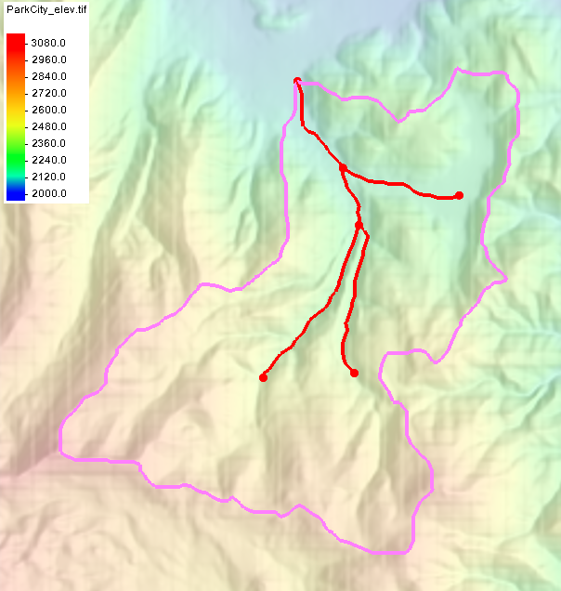
Watershed Delineation
Input
DEM
Outlet Point
Workflow Options
Currently 2
Accumulation threshold

Slide 14
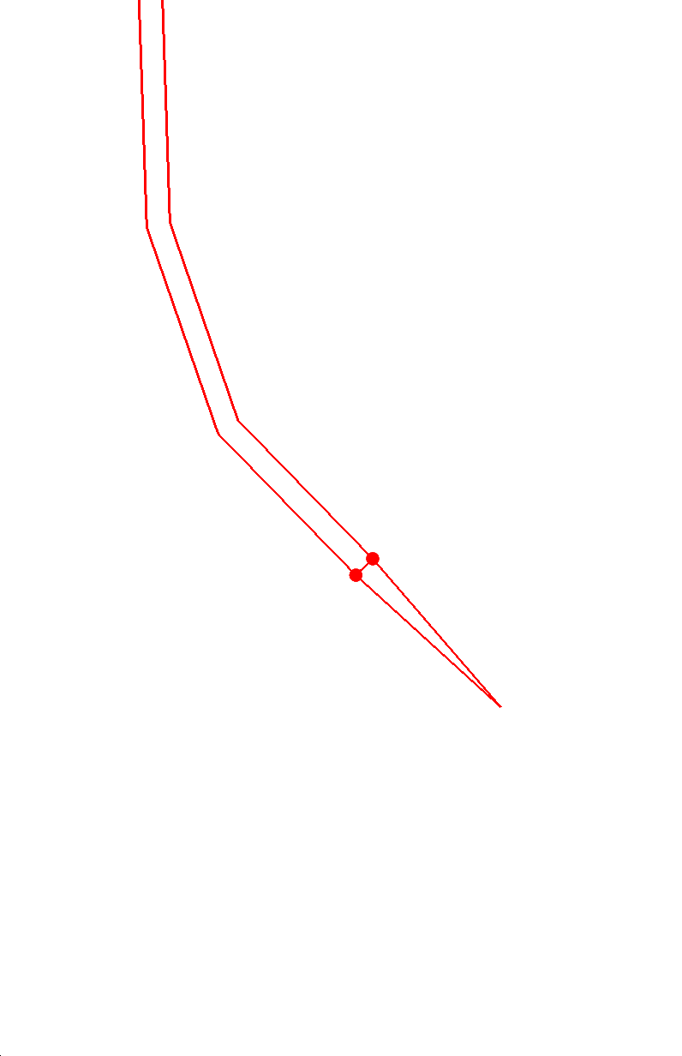
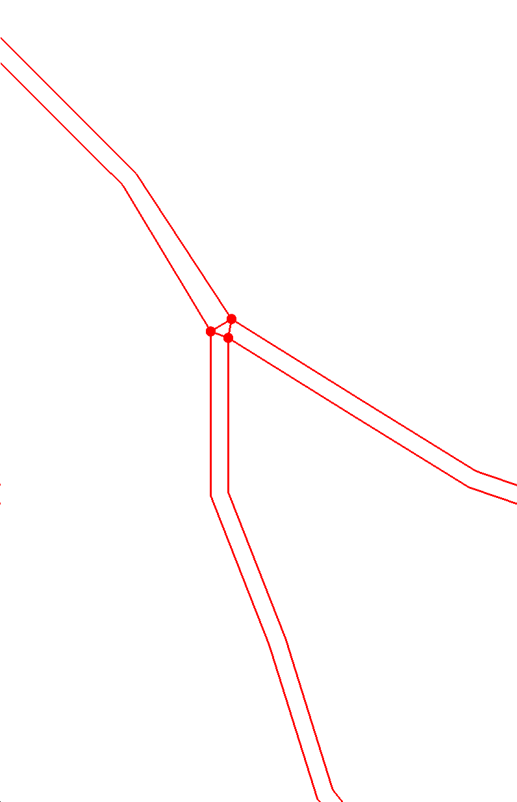
Stream Networks to Channel Polygons
Channel patches
# of cells across
Size and bias
Auto-redistribution
Confluences / Intersections
Merge with basin
Notes:
Confluences or intersections can result in odd shaped polygons, but it is handled in an generally acceptable way.
Clean up of resulting coverage available

Slide 15
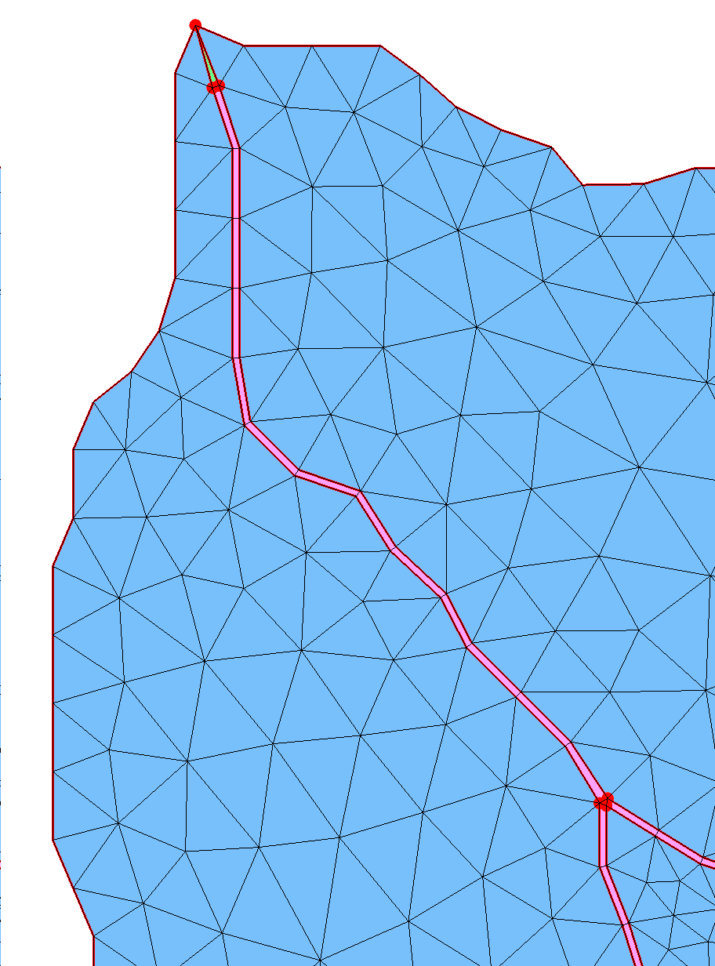
Resulting Grid / Mesh
Mesh Generation
Domain field
Flood plains / Basin
“Auto patch”
Mesh Characteristics
Matches features
Minimal interaction
May require manual cleanup
Not necessarily a bad thing
Notes:
Mesh steps
Assign all polygons at once
Elevation source
Patching
Auto-detects
Which polygons are valid patches
Which nodes in polygon are “corners” or “split”
Select “Basin” polygons
Not patches or manual
Constant paving (background resolution specified)
Create “2D Mesh from Coverage”
New python version
Faster
Higher quality cells/elements

Slide 16
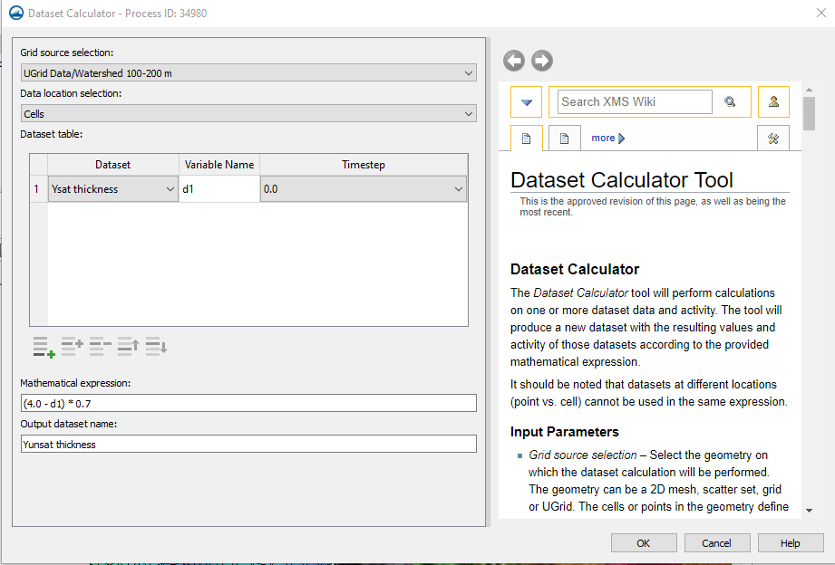
Dataset Calculator
Any Geometry
Mesh, UGrid, Scatter, …
Cell or Node
Expression
Saved in history
“where” operator
Min / Max
Conditional / If
Notes:
Examples and capabilities documented in the wiki, which is available as part of the tool

Slide 17
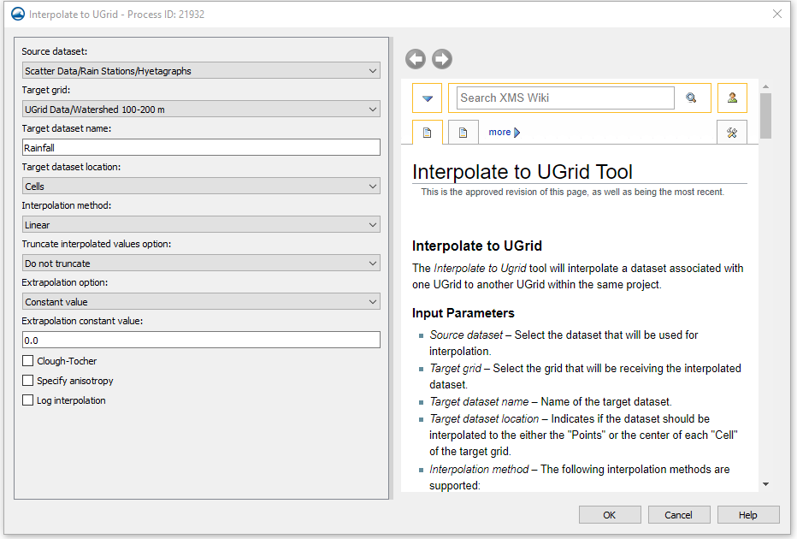
Dataset from Interpolation
Surveys (TINs)
Gages
Boreholes

Slide 18
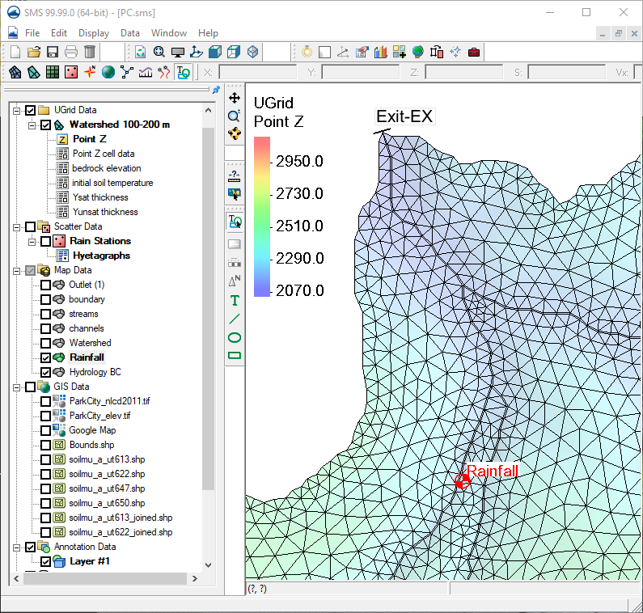
Coverages / Layers
Rainfall stations
Exit location
Monitor / Gages

Slide 19
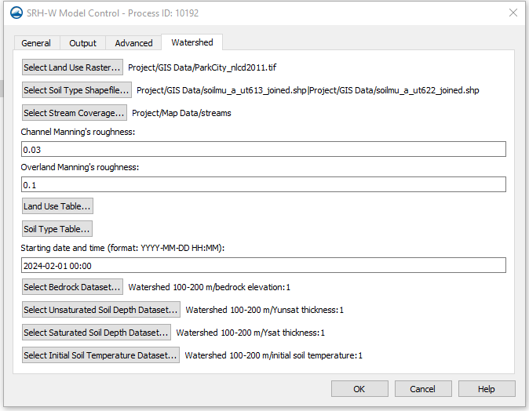
Model Parameters
Simulation based
Like SRH-2D
Intuitive
Familiar

Slide 20
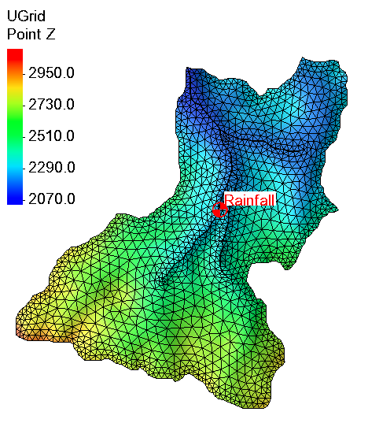
Output
Hydrographs
Stations
Output
Water levels
Notes:
Add a hydrograph

Slide 21
FHWA Hydologic Modeling User’s Forum
Please join
Public.govdelivery.com/accounts/USDOTFHWA/subscriber/new?topic_id=USDOTFHWA_213

Slide 22
Conclusion
Features available currently in SMS
Can be applied to hydraulic models
Engine (SRH-2D) applied internally
Questions…
Megan Frye – megan.frye@dot.gov
Alan Zundel - azundel@aquaveo.com

Slide 23
Conclusion
Thank you!
Questions?
Demo?
Alan Zundel
azundel@aquaveo.com

